Slide 1
Detection of Human Biological Emotions using OpenCV and TensorFlow
Seminar I

Slide 2
Introduction:
Human emotions are natural expressions that people tend to make naturally, instead of any conscious effort that is accompanied by the reflexing of facial muscles
Human can quickly and even subconsciously assess a multitude of indicator such as word choice, voice inflection, and body language to discern the sentiment of other.
OpenCV and Tensorflow are used to make the system which contain face recognition, emotion detection, drowsiness detection and ID card detection.
This system can be used as a second layer of security where along with the face the emotion is also detection.
This can also be useful to verify that the person in front of camera is not just a 2-dimention representation.
The system will detect the face from the given image, after processing it and on the basis of the expression, the emotion will be recognized.

Slide 3
Problem Statement:
In mass processions individuals’ can show repulsive and violent behavior, such individual shows a pre-emotions such as anger, or despair. Which when identified using emotion recognition can avert disastrous events. Also using such emotions detection public places can be equipped with solution to suppress these behaviors.
Nowadays, more and more intelligent system are using emotion recognition models to improve their interaction with humans. This is important, as the system can adopt their responses and behavioral patterns according to the human emotion and make more natural.

Slide 4
Objective of the project
The objective of the project is to be an affordable and efficient product that can detect emotions based of input images sources.
The objective of this project is to develop a system which can analyze the image and predict the expression of the person.
An important domain where we see the importance of emotion detection is for business promotions. Most of the businesses thrive on customer responses to their product and offers.
The main purpose of this system is to classify human emotion based on their facial appearance Here are the different type of emotion: anger, happy, supplies, sad, fear, disgust, peace, sorrow, courage.

Slide 5
Literature Survey:
Face recognition and emotion analysis is a far fetched process in the field of digital imagery and computational analysis , by providing resources to be used as biometric verification and security surveillance.
A face recognition based emotion detection is highly accurate as it does not rely on more stable and non‐alterable physiological aspects as opposite to behavioural aspects which are prone to alteration due to medication or prolong disease
The brief analysis of the face detection techniques using effective statistical learning methods are crucial as practical and robust solutions.

Slide 6
Process of Emotion Detection
Data Set Collection
Face Normalization
and Detection
Feature Extraction (Vector)
Data set classification and Model generation
Emotion Reoganization
In the next step, anthropometric data set‐based system predicts the approximate location of the principal features such as eyes, nose and mouth. whole procedure is repeated to predict the sub features, relative to principal features, and verified with collocation statistic to reject any misallocated features.
Dedicated anchor points are generated as the result of geometric combinations in the face image and then it starts the actual process of recognition. It is carried out by finding local representation of the facial appearance at each of the anchor points
The data set are transferred for classification and processing through respective algorithms designed for emotion recognition.
The emotion processor validated the input feature set with valid known feature set as a probabilistic approach .The emotional states with most weighted probability is devised.
The first stage is face detection in the acquirement of image that is regardless of scale and location. It often uses an advanced filtering procedure to distinguish locations that represent faces and filters them with accurate classifiers.

Slide 7
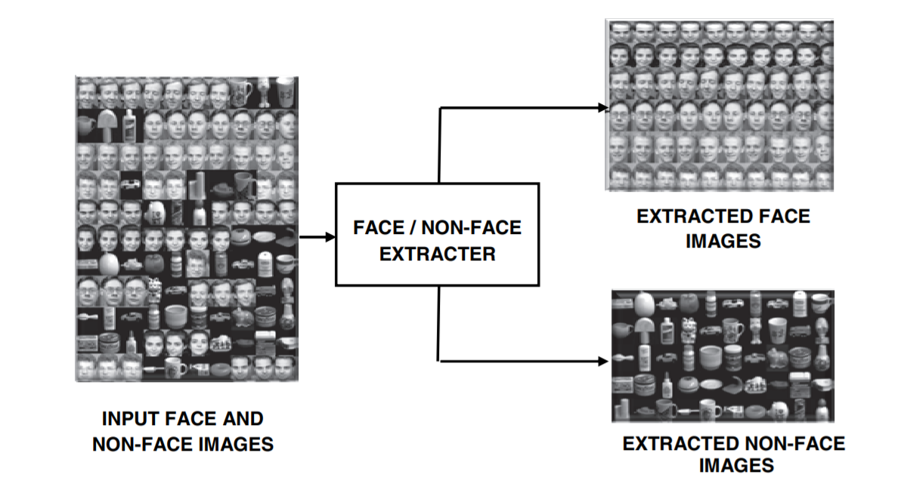
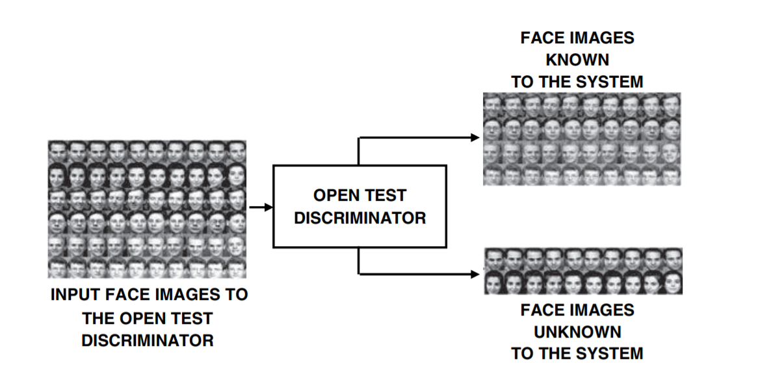
Face Detection and Identification
Face detection is the process of detecting a face in an image or video.
The process of face detection basically deals with face localization and normalization.
The localization function involve the segmentation of the face area from the background.
This may also provide the location and scale of the face. Face features such as eyes, nose, mouth and facial outline are localized during this operation
The geometrical normalization process transforms the face image into a standard frame. Warping or morphing allows more elaborate geometric normalization
Mixed face and nonface images are input to the system and the detection module discriminates between the face images and nonface images

Slide 8
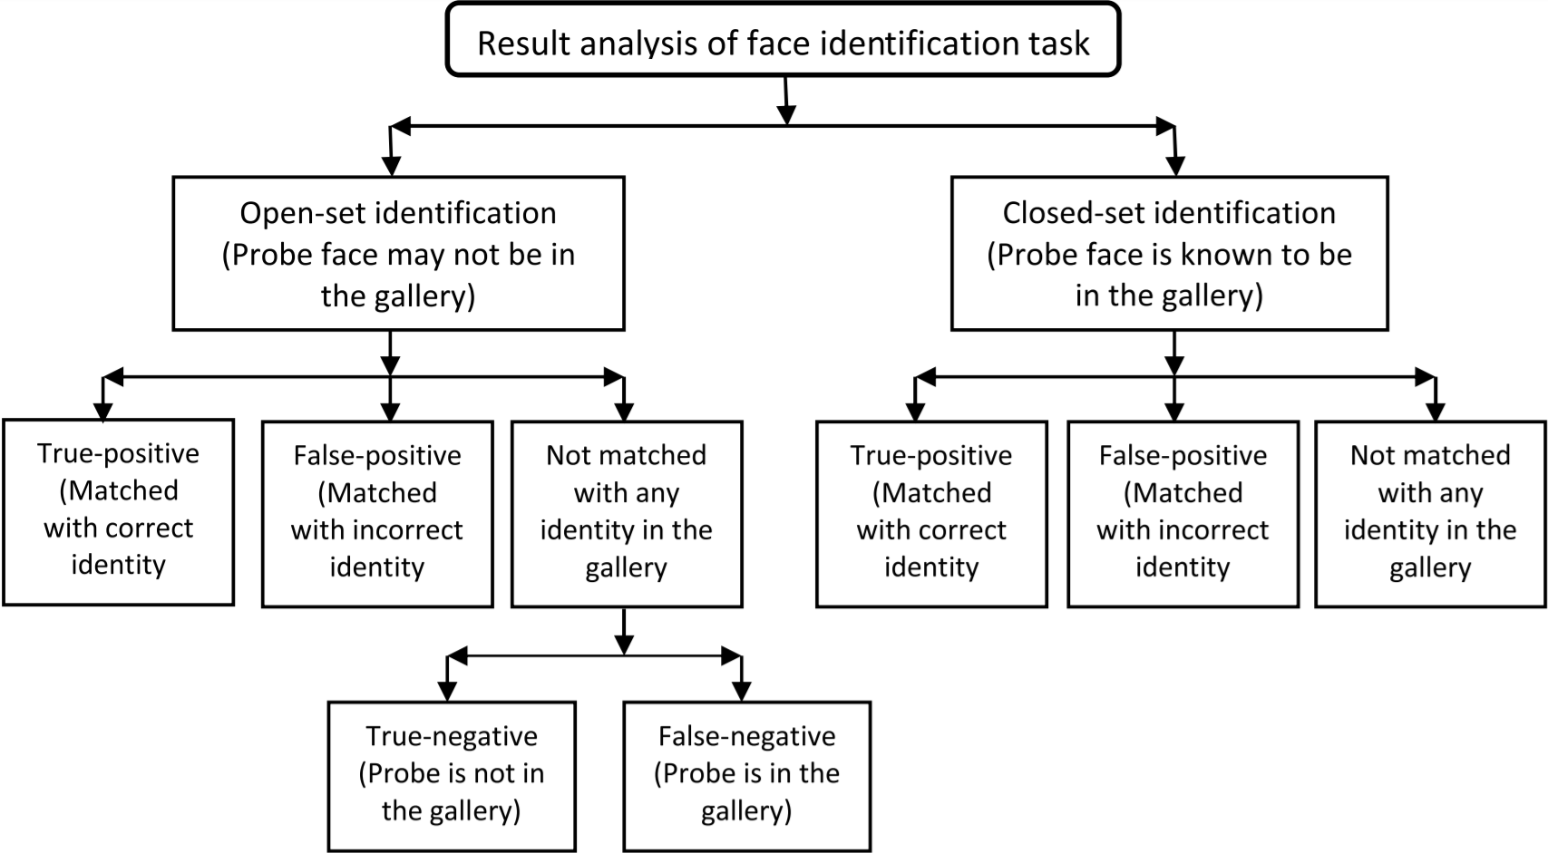
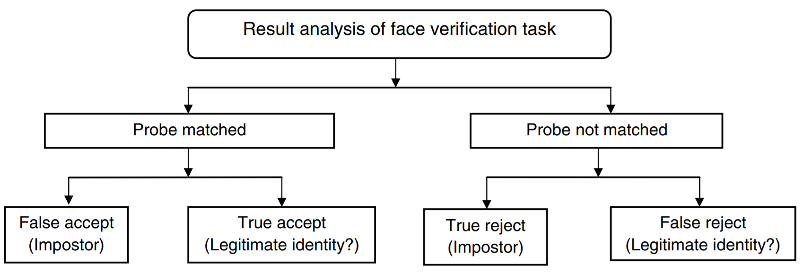
Problems in face detection and Identification
The human face is not a uniquely rigid object and there are numerous factors that cause the appearance of the face to vary.
The sources of variation in the facial appearance:
Intrinsic factors:
Intrapersonal factors: varying of facial appearance due to age, facial expression and cosmetics.
Interpersonal factors: difference due to ethnicity and gender
Extrinsic factors: disturbance due to reflections or distorsion in capture device
Liveliness detection, which aims at recognition of human physiological activities as the liveliness indicator to prevent spoofing attacks.

Slide 9
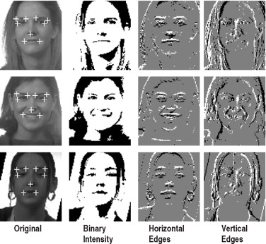
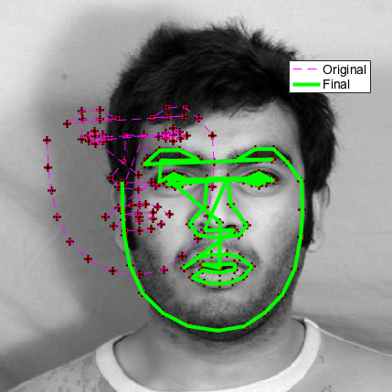
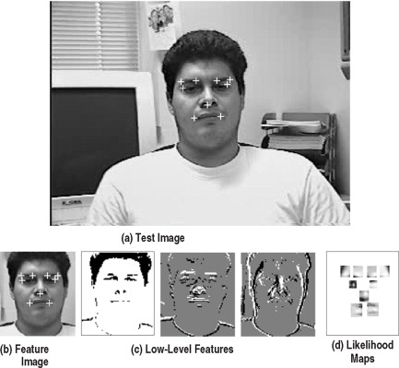
Methods in face detection.
The human face is a dynamic object and has a degree of variability in its appearance
Feature-based approaches for face detection
Low-level analysis
Edges : a line-follower implemented with the curvature constraint to prevent it from being distracted by noisy edges
Grey-level : searches for local gray minima within segmented facial regions.
Color information in face detection : color thresholds where skin color is modeled through histograms or charts converting RGB colors into YIQ representation.
Motion-based analysis : achieve motion segmentation is by frame difference analysis.
Active shape model : Active shape models depict the actual physical and, gradually deforms to take the shape of the feature
Feature analysis : determination of prominent facial features and hypothesizing other less prominent features using anthropometric measurements
Image-based approaches for face: classifies examples into face and non-face prototype classes. Comparison between these classes and a 2D intensity array extracted from an input image allows the decision of face existence to be made
Statistical approaches: The training procedure results in a set of look-up tables with likelihood ratios.
Edge analysis
Active shape model
Low level feature analysis

Slide 10
Methods in Face Recognition
Face recognition is the process of detecting face in an image and then using algorithms to identify who the face belongs to. Face recognition is thus a form of person identification
Geometric feature-based method -Combination of geometric characteristics and distance between detected significant facial features to represent face
Subspace-based face recognition -use a training set to compute a coordinate space
Neural network-based face recognition-The basic idea is to consider a net with a neuron for every pixel in the image. the face image, is approximated by a vector with smaller dimensions by the first network (auto-association), and then this vector is finally used as input for the classification net
Correlation-based method -computation of the normalized cross correlation coefficient.
Matching pursuit-based methods best decomposition of a set of images by iteratively optimizing a cost function
Support vector machine approach is a K class problem.

Slide 11
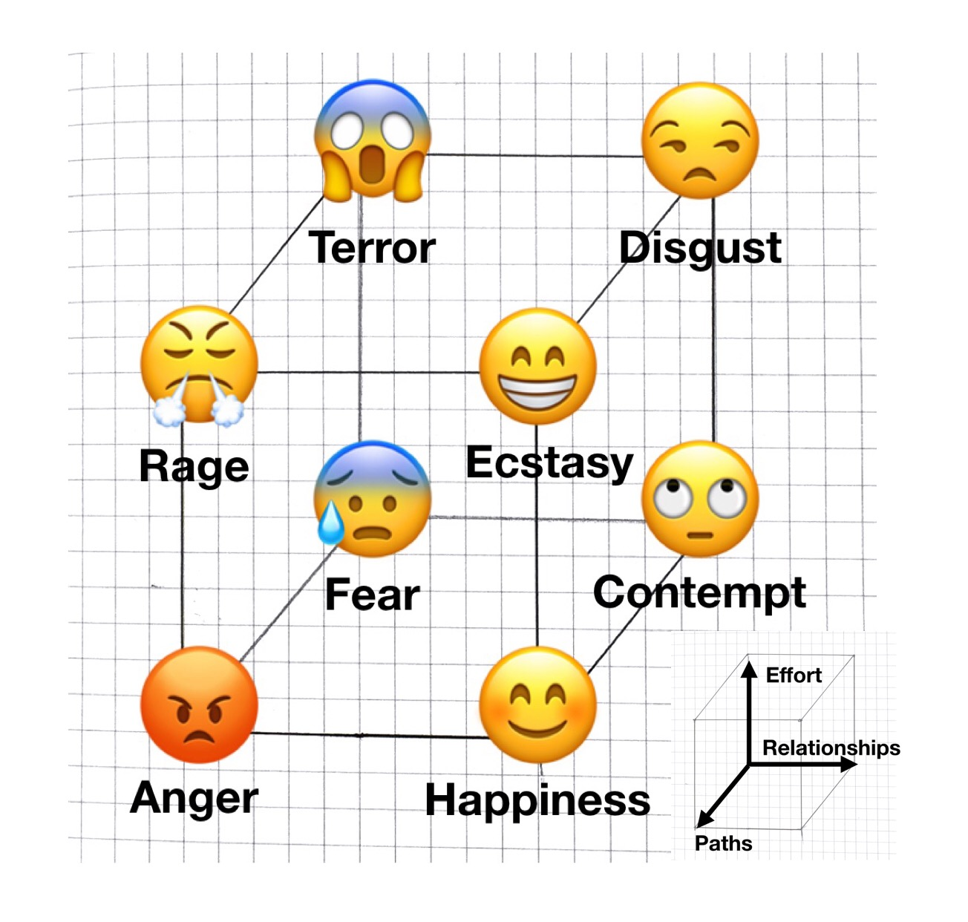
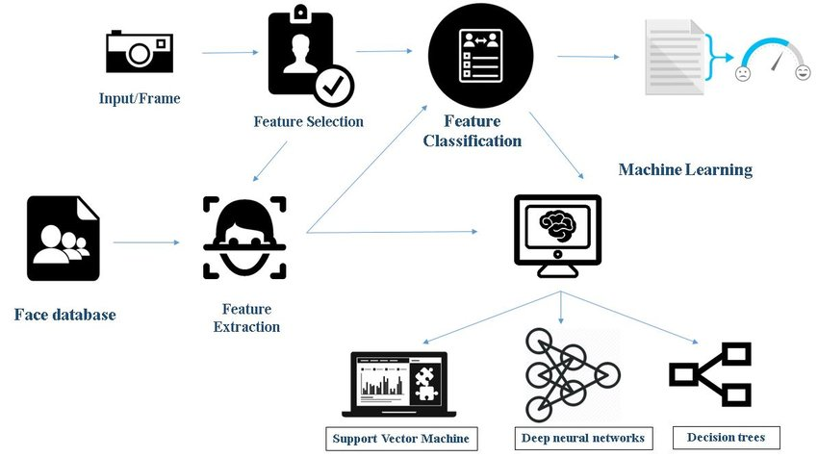
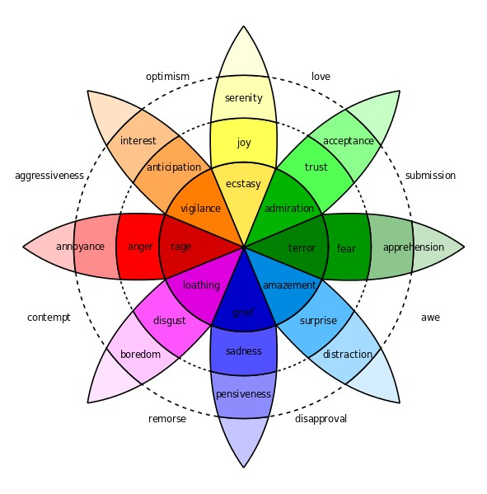
Emotion identification
Emotion identification is the process of identifying human emotion from the feature set identified as from the various methods of face detection and identification.
The data set and vectors received by various algorithms are transferred to various network and preceptory and statistical models.
The models validate the feature vectors against known models and generate probabilistic data. The various methods used are:
Support vector machine-support-vector machines are supervised learning models with associated learning algorithms that analyze data used for classification and regression analysis
Deep neural networks-A deep neural network (DNN) is an artificial neural network (ANN) with multiple layers between the input and output layers
Decision tree-A decision tree is a decision support tool that uses a tree-like model of decisions and their possible consequences, including chance event outcomes, resource costs, and utility.
Lövheim Cube of Emotions - presents signal substances forming the axis of the coordination system and the eight basic emotions are placed at the eight corners of the cube.
Plutchik’ model: [19]Plutchik gave a hybrid model arranging the emotions into concentric circles with inner being the basic and the outer more complex emotions.
Lövheim Cube of Emotions
Plutchik’ model

Slide 12
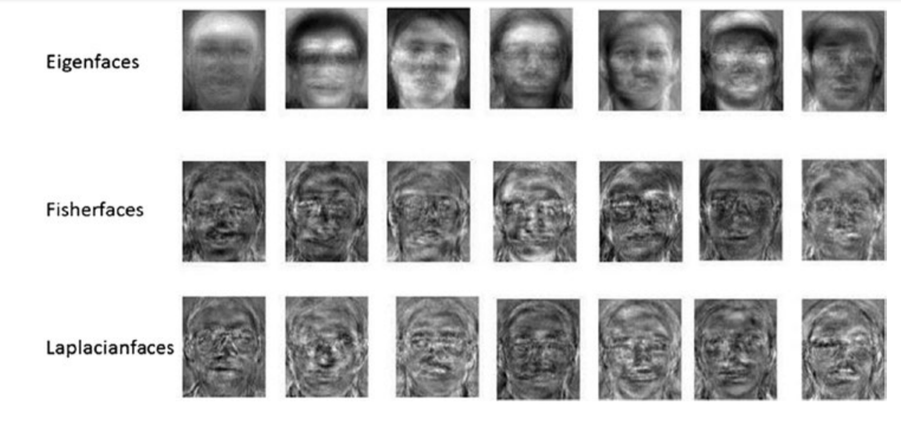
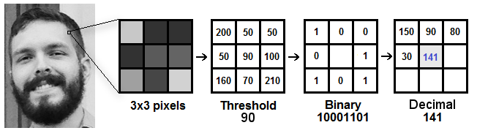
Methodology:
The detection and recognition implementation proposed here is a supervised learning modal that will use the one-versus-all (OVA) approach to train and predict the seven basic emotion (anger, contempt, disgust, fear, happiness, sadness, and surprise), using OpenCV and Tensorflow.
OpenCV provides various algorithms for face detection and identification
•Eigen faces:Involves projecting face images from a higher dimension to lower dimension.
• Fisher faces: Data is assumed to be uniformly distributed in each class
• Local Binary Patterns Histograms: labels the pixels of an image by thresholding the neighborhood of each pixel and considers the result as a binary number.
Fig. Sample images of various algorithms

Slide 13
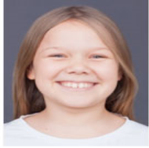
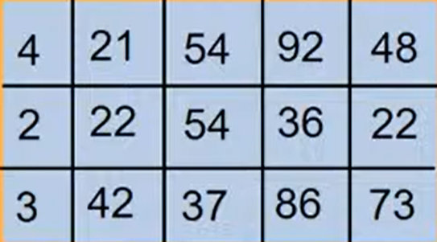
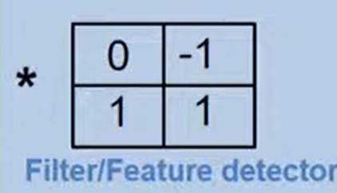
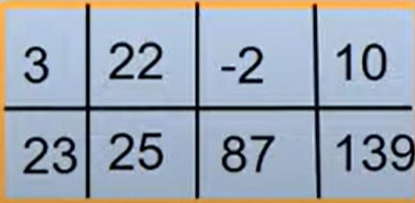

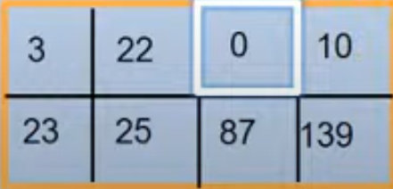
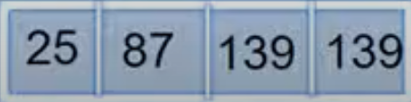
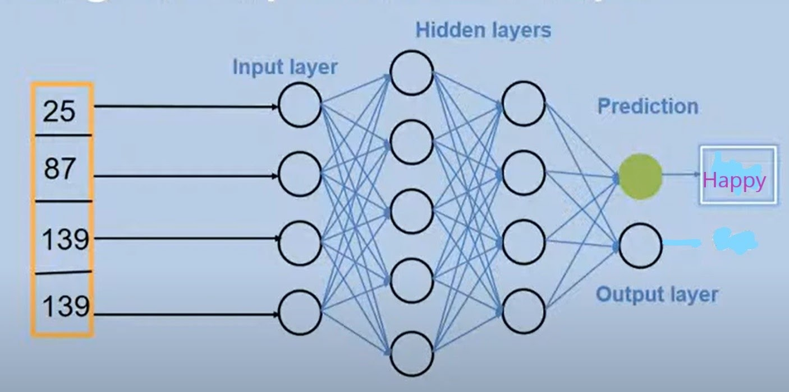
OpenCV provides methods for face detection and identification.
Classification and Regcognization of image is done through a CNN model trained using feature sets.
The model to be used in feature detection contains:
1.Convolution Layer:Convert images into array.
2.ReLu Layer: It is a half rectifier. Converts negative value to zero.
3.Pooling Layer:Helps to Control overfitting
4.Fully connected layer: Combines all the features together to create a final model

Slide 14
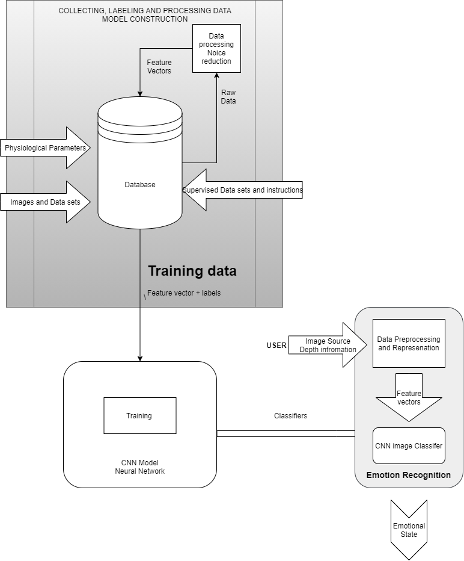
CNN process flow
The system will use Haar feature-based cascade classifiers
The process will use Multi-task Cascade Convolutional Neural Network to detect emotions.

Slide 15
Hardware/Software Requirement
Hardware specification:
Processor: Intel core Duo 1.2 GHz or higher AMD
Ryzen 2 1.0 GHz or higher
Ram: 2 GB DDR4 2400 MHz or higher
Host OS: Windows 7 SP1, Ubuntu Linux 16.07 or higher
with webcam support
Software specification:
Front-End: Python, C++
Development Environment: JetBrains Pycharm 2020.2.1
Back-End: OpenCV 2.4.13.7, TensorFlow Core 2.3.0
UI Interfacing: PyQt, Tk
VCS (Version Control System): Local – Git 2.27
Cloud- Microsoft Github

Slide 16
References:
Wan, S., & Aggarwal, J. K. (2013, April). A scalable metric learning-based voting method for expression recognition . In Automatic Face and Gesture Recognition (FG), 2013 10TH IEEE International Conference and Workshops on (pp. 1-8). IEEE,
[OpenCV Dev Team] “Welcome to opencv documentation!” Dec 31, 2019 , Access Online: September 9, 2020 , Available : https://docs.opencv.org/2.4/index.html
M. Xiaoxi, L. Weisi, H. Dongyan, D. Minghui and H. Li, "Facial emotion recognition," 2017 IEEE 2nd International Conference on Signal and Image Processing (ICSIP), Singapore, 2017, pp. 77-81, doi: 10.1109/SIPROCESS.2017.8124509.
Turabzadeh, S,; Meng, H.; Swash, R.M.; Pleva, M.; Juhar, J. Real-time emotional state detection from facial expression on embedded devices. In Proceedings of the 2017 Seventh International Conference on Innovative Computing Technology (INTECH), Luton, UK, 16-18 August 2017; pp.46-51.
“TensorFlow Core”[Online] Accessed: September 9, 2020 ,Available : https://www.tensorflow.org/guide
C. Jain, K. Sawant, M. Rehman and R. Kumar, "Emotion Detection and Characterization using Facial Features," 2018 3rd International Conference and Workshops on Recent Advances and Innovations in Engineering (ICRAIE), Jaipur, India, 2018, pp. 1-6, doi: 10.1109/ICRAIE.2018.8710406.

Slide 17
Thank You
Presentators:
Sagar Ramrao Bharad
Prashish Gautam Borkar
Shreya Bhojraj Gawali
Janhavi Jayant Karande
AnilKumar Ramji Sharma

